Slide 1
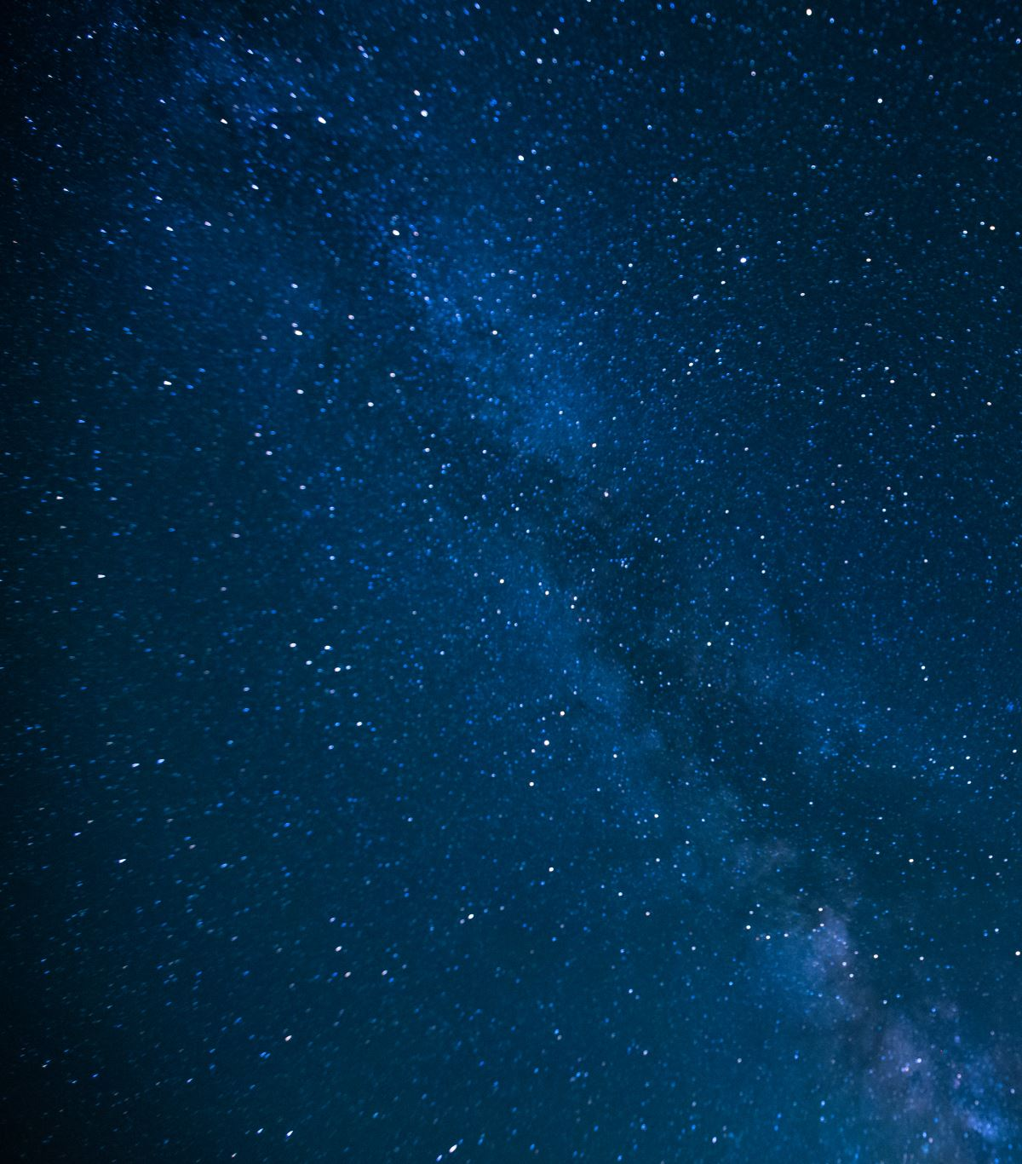
The Detection of Exoplanets Orbiting Stars in the Milky Way Galaxy using data produced by the Kepler Space Telescope

Slide 2

AIMS
1. The construction of a master data set from the Kepler Space Telescope data archive.
2. Develop 3 classification models, independently, with variations in the methodologies of exoplanet classification.
3. Produce a composite-master model that is comprised of the 3 component classification models.
4. Conduct rigorous experimentation with the designed model with the domain expertise of the Astronomer and Astrophysicist in order to potentially find a new exoplanet and prove it academically.

Slide 3

Background
The data has been collected by the Kepler Telescope – in operation for 9 years.
An exoplanet is detected using the transit spectroscopy theory, ie, the decrease in the amount of light when an object moves in from of a light source.
Neural networks have been successfully implemented in the past.
This project aims to depart from the neural network methodology in order to innovate an improve results.

Slide 4
Research Project
The significance of the problem concerns the current state of academics in the fields of astronomy and astrophysics.
1
Why is the problem important? We could potentially discover a world that supports life, or intelligent life.
2
Tree-based classification models and a non-linear hyperplane separator model will be developed instead of a neural network.
3
The ideal outcome: discover a new exoplanet and contribute to the fields of astronomy or astrophysics.
4

Slide 5
Budget
5 people will be involved;
An Astrophysicist
An Astronomer
A Statistician
2 Data Scientists
Equipment;
5 high powered laptops
Access to 2000 hours of Amazon Web Services EC2 computation
Total cost: approximately $550,000

Slide 6
Personnel
Astrophysicist: Consult on the application of the transit spectroscopy theory to the data analysis.
Astronomer: Consult on the behaviour of exoplanets and star systems in order to interpret the data set for analysis.
Statistician: Assist with the transformation of the data in order to extract meaningful variables.
Data Scientist: Build the machine learning models and tailor said models to the recommendations of the Astrophysicist, Astronomer and Statistician.

